Slide 1
Lecture 13
Decision structures
if construct,
else statement
&
elseif statement.
© 2010 Daniel Valentine. All rights reserved. Published by Elsevier.

Slide 2
Uses of the if construct
The if-end decision construct is useful when relational operations are used to decide whether or not to execute a sequence of commands.
  You can use them for displaying messages.
  You can use them to prevent undesired operations, e.g., you may wish to skip the log(x) command for x≤0. (Of course, since MATLAB deals with complex numbers, the log of a negative number is a legitimate mathematical operation.)

Slide 3
The if construct
The basic if construct has the form:
if comparison
action
end
When the comparison is true, it moves on to the action.
When the comparison is false, the program skips to the end statement.

Slide 4
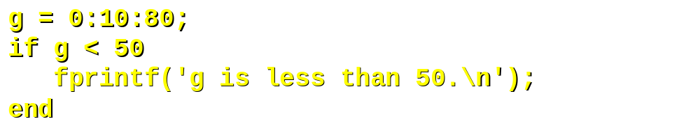
if constructs with arrays
When the comparison includes an array, all elements are compared. An if construct requires all elements to be true.
Since some elements of g are greater than 50 the statement is false so it skips to end. There is no output.

Slide 5
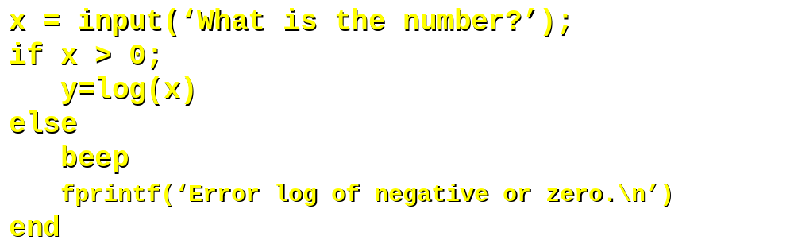
else
The else command is another element in an if construct. When the if comparison is false, commands after else are executed.
Note: MATLAB has a function to make the computer beep. You may use this as an error notice. You need to have your volume up to hear it.

Slide 6
elseif
There can be any number of elseif clauses, however there may only be one else clause. elseif is useful when you have multiple comparisons to test.
if grade>=90
fprintf('A\n');
elseif grade>=80
fprintf('B\n');
elseif grade>=70
fprintf('C\n');
elseif grade>=65
fprintf('D\n');
else
fprintf('F\n');
end
Note that the first elseif argument that is true will be executed.

Slide 7
Hands on
Write a function to determine if the length of a part is 10 cm with a 2% tolerance.
In the previous problem write a function to permit input in inches. Note that 1 inch = 2.54 cm.
Write a program to ask for input of a temperature. If the temperature is > 25ºC, print ‘fan on’, otherwise print ‘fan off’.
In previous problem ask for input in Fahrenheit.

Slide 8
Summary
Decision making
The if construct
  if logical operation (i.e., comparison)
  possible action one
  elseif logical operation
  possible action two
  else
  possible action three
  end

